Slide 1
Protecting Yourself and
Reducing the Spread of
COVID 19

Slide 2
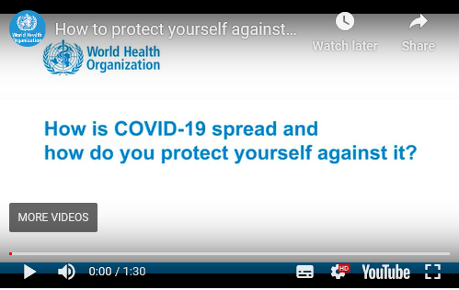
COVID 19 – Coronavirus
How do we protect ourselves
https://youtu.be/1APwq1df6Mw

Slide 3
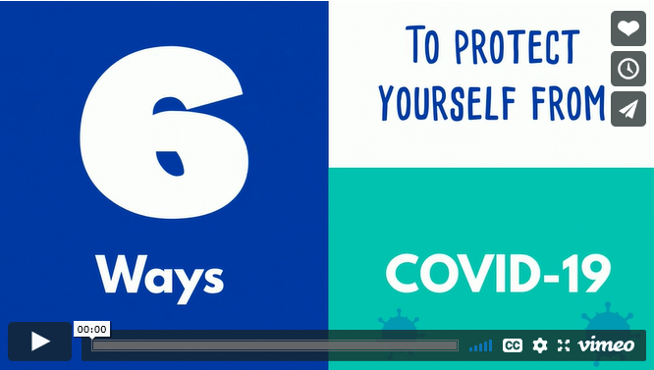
How can we protect each other
6 ways to protect ourselves
Maintain good standards of hygiene, wash your hands regularly
Practice respiratory hygiene
Maintain social distancing
Avoid touching your eyes, nose, and mouth
Masks and PPE
https://openwho.org/courses/eprotect-acute-respiratory-infections

Slide 4
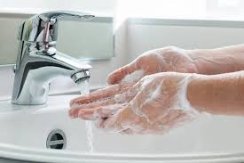
What can we do in our workplace
Common areas to be aware of:
Be conscious when handling documents at receipts areas, gantry, office areas and ensure you wash your hands or use hand sanitiser on a regular basis. Avoid touching your face with your hands specifically the eyes, mouth, and nose.
You must maintain social distance – respect each others space (minimum 2 metre), even when walking to and from the workplace /during work activities/canteen during rest breaks/ kitchen areas/locker rooms/ toilets/ office/ and be careful when handing over paperwork
Operating machinery, door handles/ hand levers/ operating controls, using handrails/ gangway’s, vending machines small appliances i.e. radios, kettles. Again, regular hand washing with hot soapy water and use of sanitiser.

Slide 5
Vulnerable groups
https://www.gov.uk/government/publications/covid-19-guidance-on-social-distancing-and-for-vulnerable-people/guidance-on-social-distancing-for-everyone-in-the-uk-and-protecting-older-people-and-vulnerable-adults

Slide 6
Social Distancing
What is social distancing?
Social distancing is a term used to describe the steps taken to reduce the social interaction between people which will help reduce the spread of COVID-19.
They are:
Avoid contact with someone who is displaying symptoms of coronavirus (COVID-19) - these symptoms include high temperature and/or new and continuous cough
Avoid non-essential use of public transport - when possible, alter your travel times to avoid rush hour
Work from home, where possible - your employer supports you to do this
Avoid large gatherings and small gatherings in public spaces - pubs, restaurants, leisure centres and similar venues are currently closed as infections spread easily in closed spaces where people gather together
Avoid gatherings with friends and family - keep in touch using remote technology such as phone, internet, and social media
Use telephone or online services to contact your GP or other essential services
Stay 2m apart from others

Slide 7
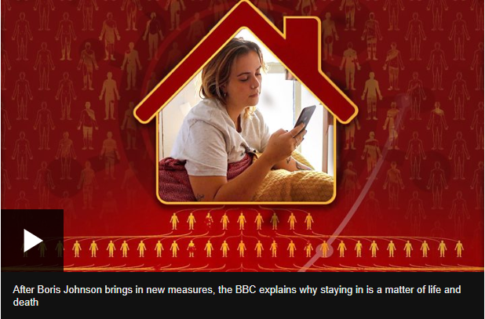
Why is social distancing necessary
Social distancing
Is important because coronavirus spreads when an infected person coughs small droplets - packed with the virus - into the air.
These can be breathed in, or can cause an infection if you touch a surface they have landed on, and then touch your face with unwashed hands.
The less time people spend together, the less chance there is of this happening.
https://www.bbc.co.uk/news/av/health-52008673/uk-lockdown-why-does-staying-at-home-stop-coronavirus

Slide 8
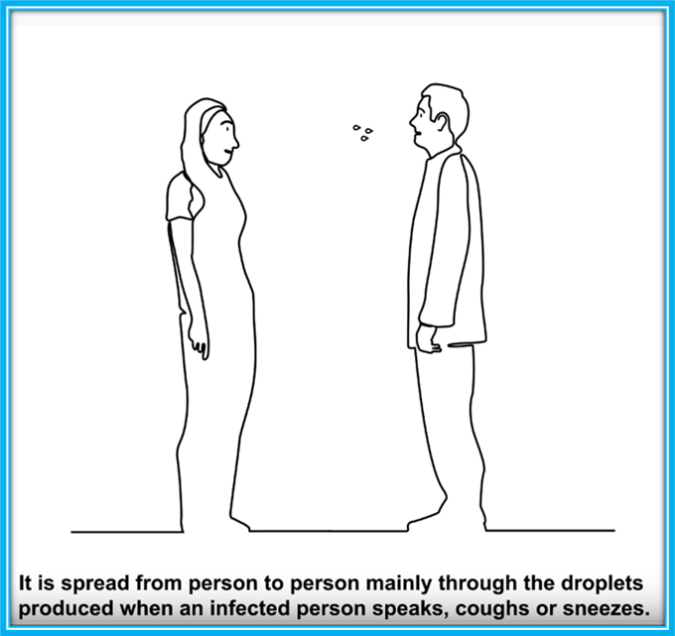
Good health and hygiene practices
The important thing to remember is that good health and hygiene practices provide for the best defence against coronavirus. So, you should:
Wash your hands frequently with hot soapy water
When coughing and sneezing, cover your mouth and nose with a flexed elbow or a tissue
Maintain at least 2 metres distance between yourself and other people, especially if they appear to be ill
Avoid touching your eyes, nose and mouth
If you have a fever, cough and difficulty breathing, seek medical care early
Challenge people who are not practicing Social Distancing or any of these simple practices. It will help to save lives.
2 Metres

Slide 9
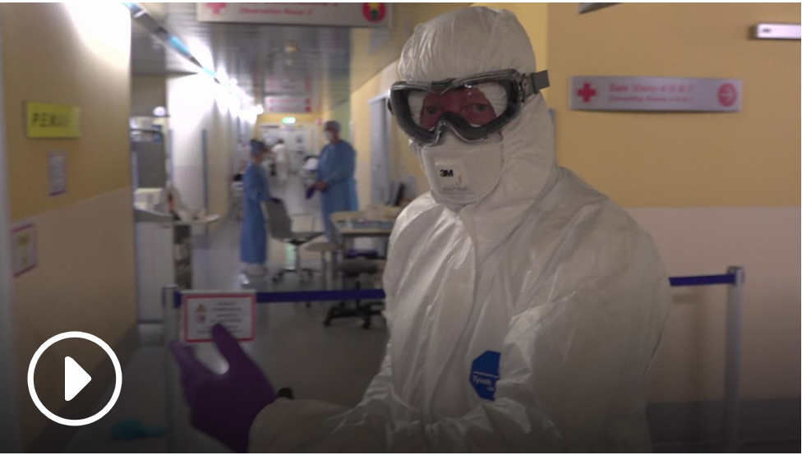
What happens if we don’t all practice Social Distancing?
Coronavirus: Italy's hardest-hit city wants you to see how COVID-19 is affecting its hospitals
As you can see, this is serious and we all need to do our bit to protect ourselves and prevent any further spread of COVID-19.
https://news.sky.com/story/coronavirus-they-call-it-the-apocalypse-inside-italys-hardest-hit-hospital-11960597

Slide 10
Thank you

